Slide 1

Supply Chain Dataset Analysis
Team members:
Yasmin Tarek
Basant Mohamed
Omar Ashraf
Adham El Ebrashi
Supervised by: Jackie Aboaleam

Slide 2

Project overview
The objective of this project is to analyse
a supply chain dataset by building a data model,
performing data cleaning and preprocessing,
and deriving insights through analysis,
and visualization.

Slide 3
Table of contents
Data Cleaning, and Preprocessing
Building Data Base and Data Model
Analysis Questions
Dashboard
Visualization

Slide 4
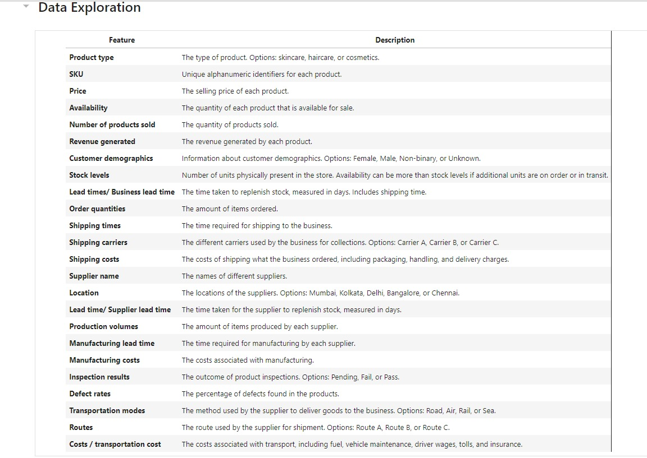
Data set features

Slide 5
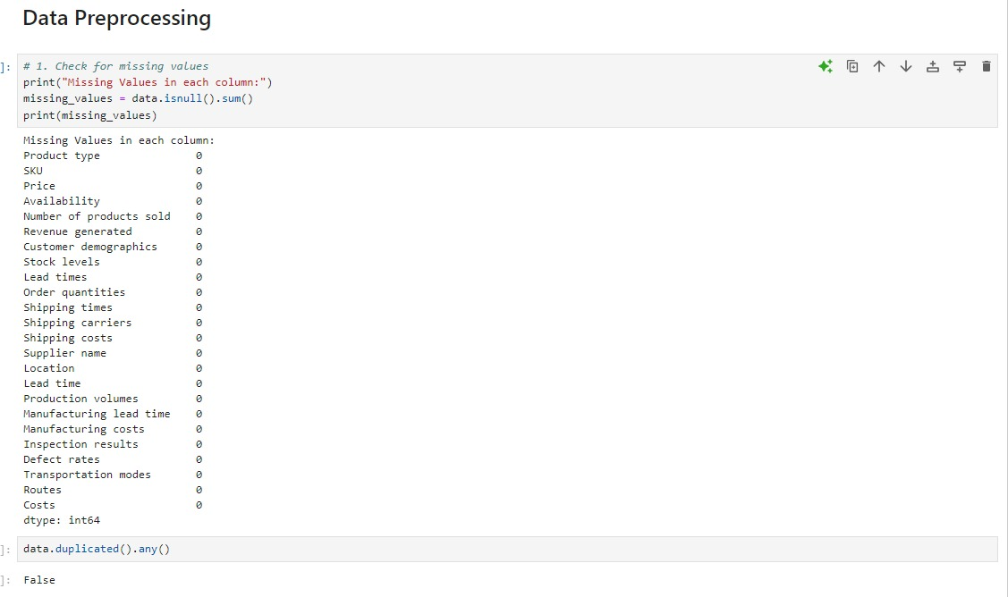
Data Cleaning and Preprocessing
Checking for missing values or duplicates in the data set

Slide 6
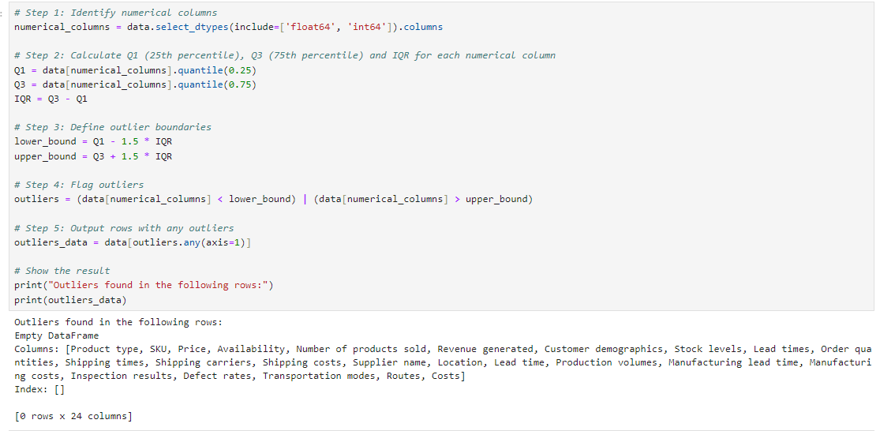
Data Cleaning and Preprocessing
calculate the
interquartile range (IQR)

Slide 7
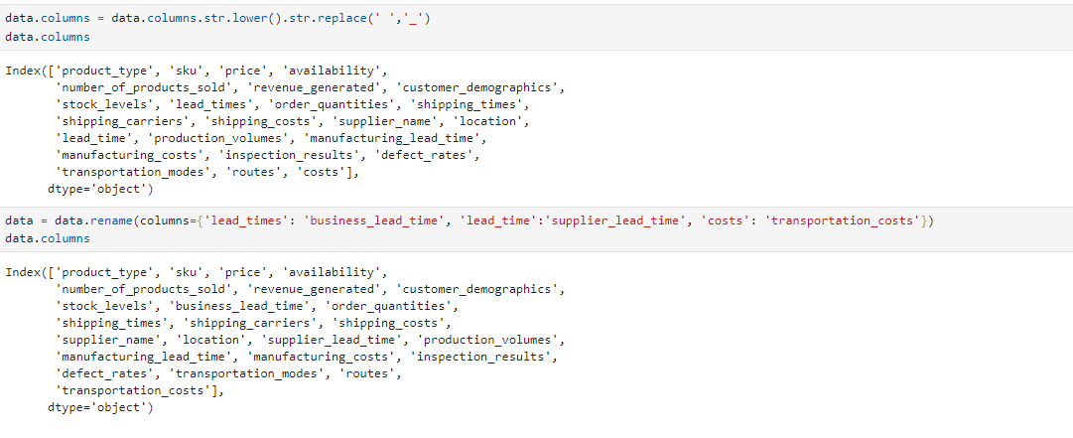
Data Cleaning and Preprocessing
renames specific columns
for clarity

Slide 8
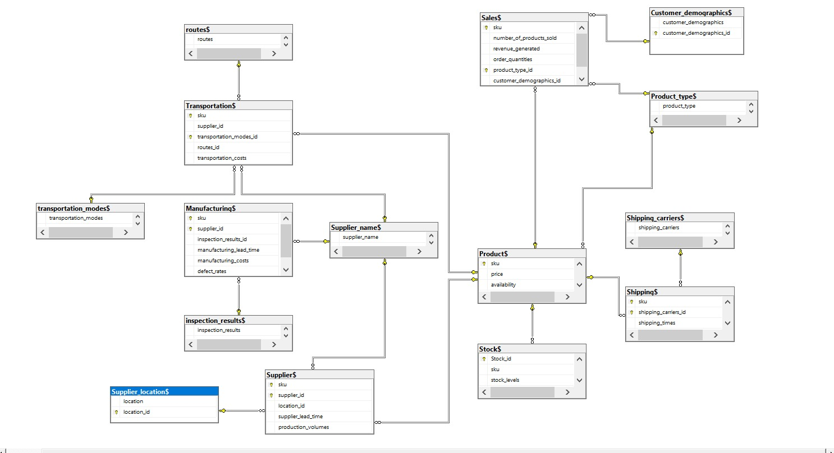
Data Base model

Slide 9
Tables and Constrains
routes
Primary Key: routes_id
Transportation
Primary Key: sku, supplier_id
Foreign Keys:
transportation_modes_id →transportation_modes$ (transportation_modes_id)
routes_id →routes$ (routes_id)
Transportation_modes
Primary Key: transportation_modes_id
Manufacturing
Primary Key: sku, supplier_id
Foreign Keys:
supplier_id →Supplier$ (supplier_id)
Supplier_name
Primary Key: supplier_id
Sales
Primary Key: sku
Foreign Keys:
product_type_id →Product_type$ (product_type_id)
customer_demographics_id →Customer_demographics$ (customer_demographics_id)
Product
Primary Key: sku
Shipping
Primary Key: sku
Foreign Keys: shipping_carriers_id →Shipping_carriers$ (shipping_carriers_id)
Stock
Primary Key: Stock_id
Foreign Key: sku →Product$ (sku)
Supplier_location
Primary Key: location_id
Supplier
Primary Key: supplier_id, sku
Foreign Key: location_id →Supplier_location$ (location_id)
Shipping_carriers
Primary Key: shipping_carriers_id
Customer_demographics
Primary Key:customer_demographics_id
Product_type
Primary Key:product_type_id
Inspection_results
Primary Key:inspection_results_id

Slide 10
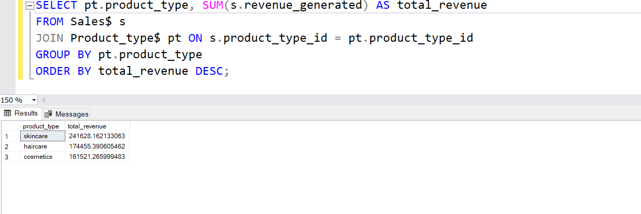
Analysis Questions
What is the total revenue generated per product type?
This question helps understand which product categories (e.g., skincare, haircare) are generating the most revenue.
We find that skincare category generated the most revenue

Slide 11
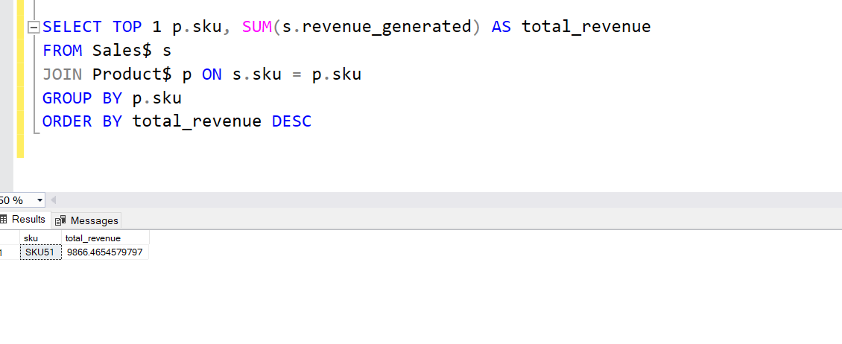
Analysis Questions
Which product SKU generated the highest revenue?
This will help identify the top-performing product in terms of revenue.
We find that Product SKU with the highest revenue is SKU51 with revenue 9866.465458

Slide 12
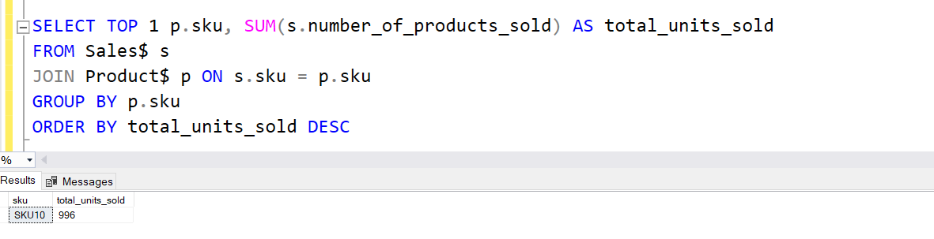
Analysis Questions
3. Which product SKU has sold the highest number of units?
This will help identify the best-selling product in terms of units sold.
We find that Product SKU10 has sold the highest number of units (996).

Slide 13
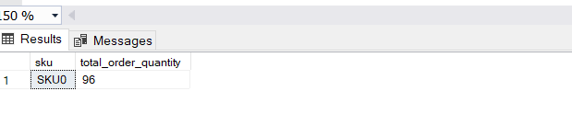
Analysis Questions
4. Which product has the highest order quantity?
This helps determine which products are ordered in bulk by customers.
We find that Product SKU0 has the highest order quantity (96 ORDER)

Slide 14
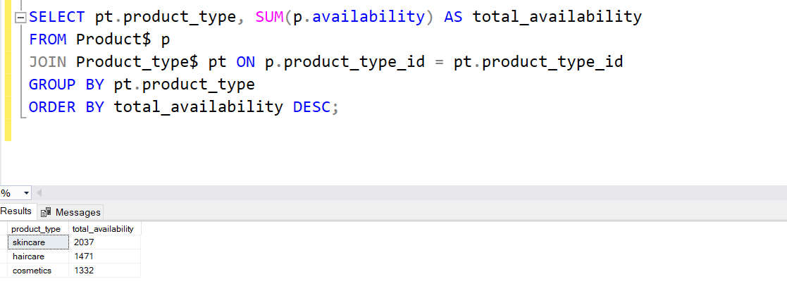
Analysis Questions
5. Which product type has the highest availability in stock?
This question helps identify which product type has the most inventory available for sale.
We find that skincare has the highest availability in stock (2037)

Slide 15
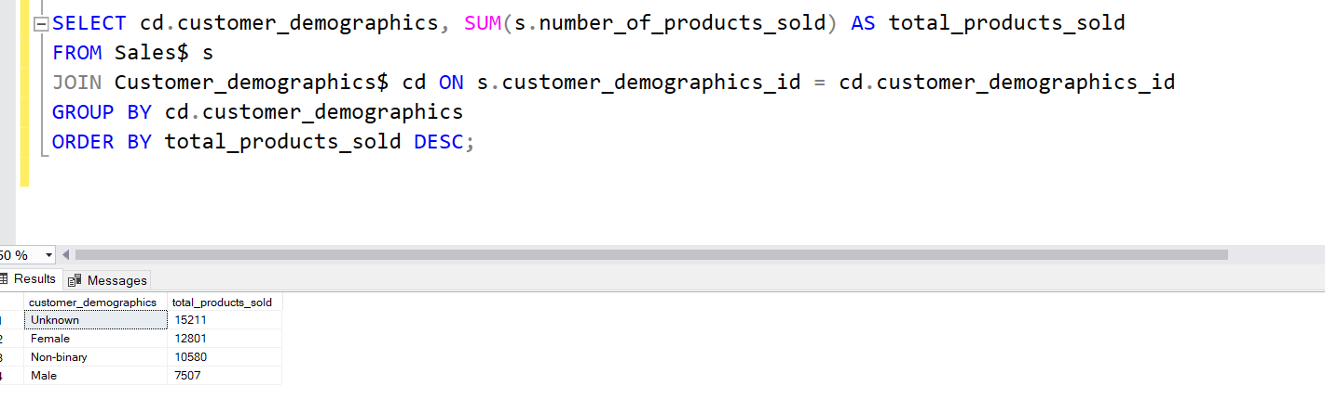
Analysis Questions
6. Which customer demographic group buys the most products?
This question helps understand the customer demographics associated with the highest sales.(UNKNOWN -> 15211 product)

Slide 16
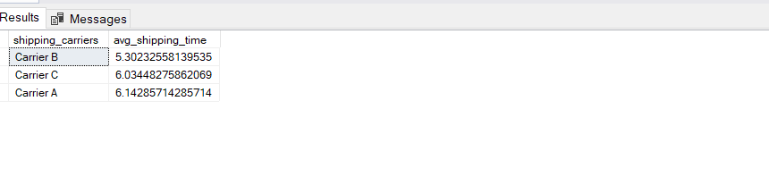
Analysis Questions
7. What is the average shipping time for each carrier?
This helps understand the efficiency of each shipping carrier based on average shipping times.
Fastest shipping carrier: Carrier B

Slide 17
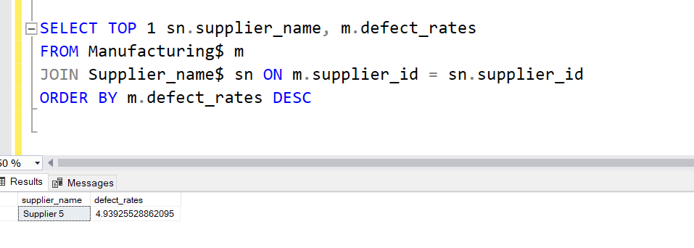
Analysis Questions
8. Which supplier has the highest defect rates?
This helps identify suppliers with quality issues based on their defect rates.(Supplier 5)

Slide 18
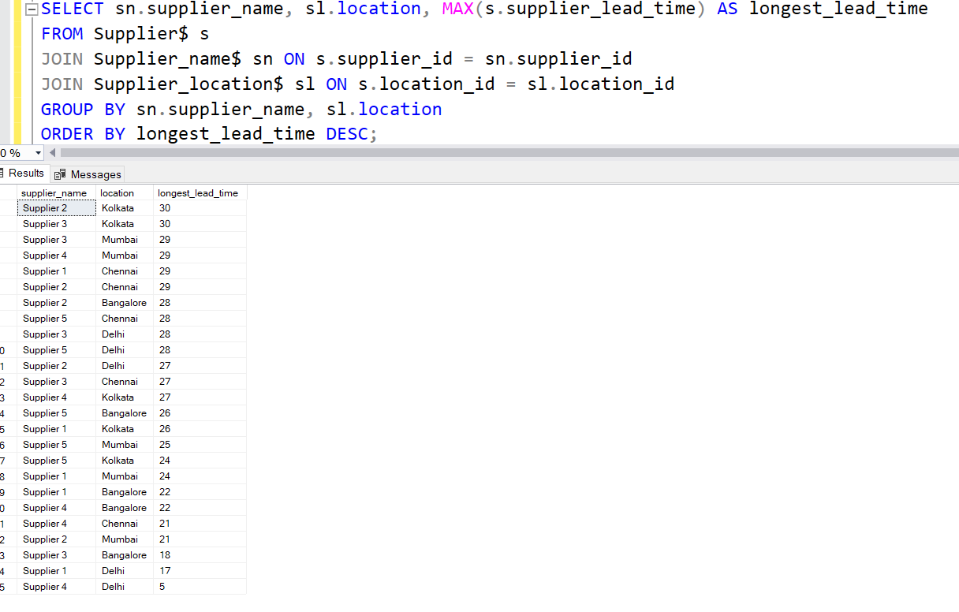
Analysis Questions
9. Which supplier has the longest lead time per location?
This will help identify which supplier, in each location, takes the longest to fulfill orders.

Slide 19
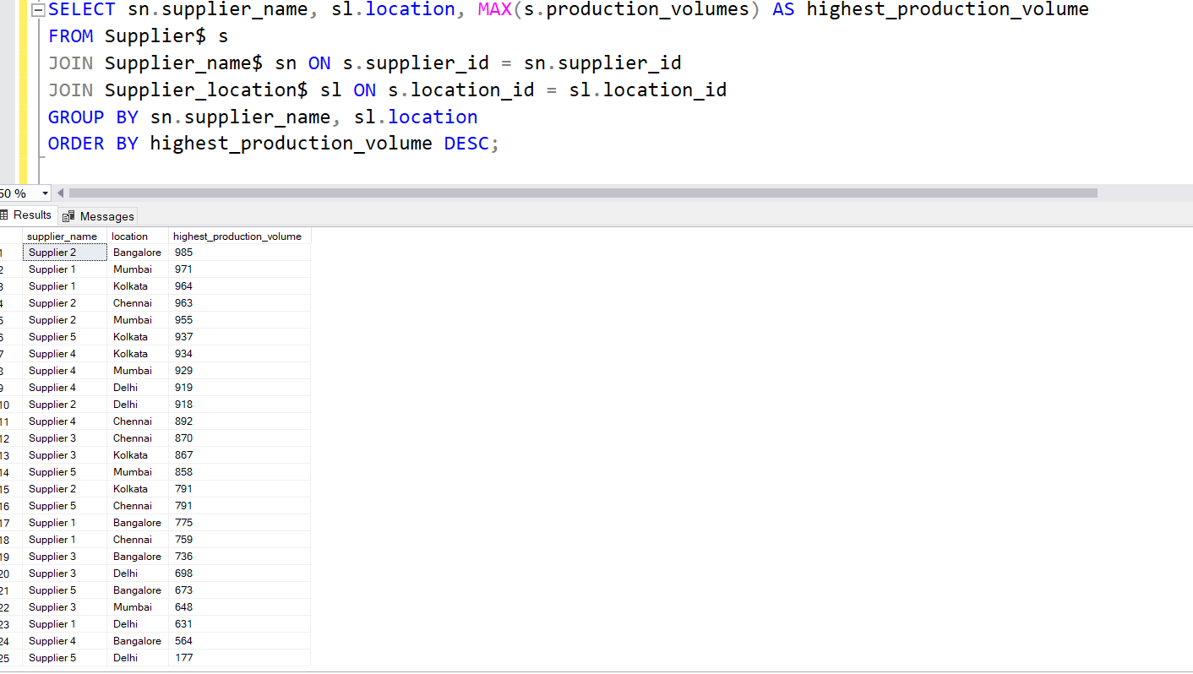
Analysis Questions
10. Which supplier in each location has the highest production volume?
This can help optimize procurement by identifying suppliers with the most capacity.

Slide 20
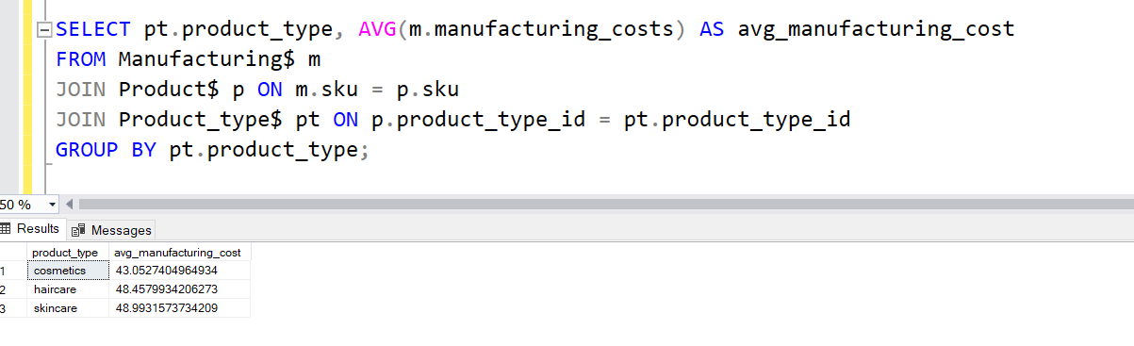
Analysis Questions
11. What is the average manufacturing cost per product type?
This question helps in understanding which product types are the most expensive to manufacture.

Slide 21
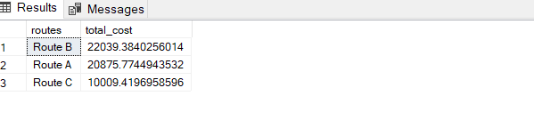
Analysis Questions
12. Which route has the highest transportation cost?
This question helps to identify the most expensive shipping route.(Route B)

Slide 22

Visualization

Slide 23
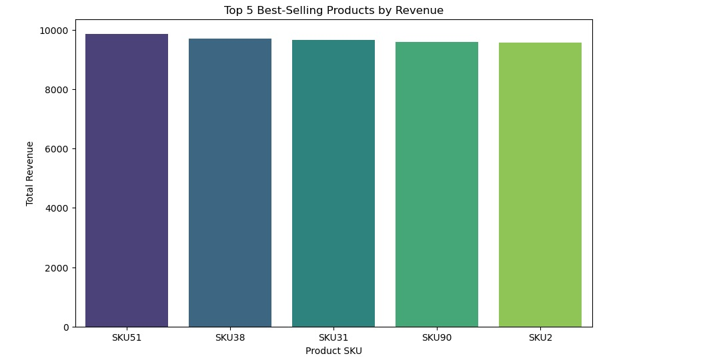
Top 5 Best selling product by revenue

Slide 24
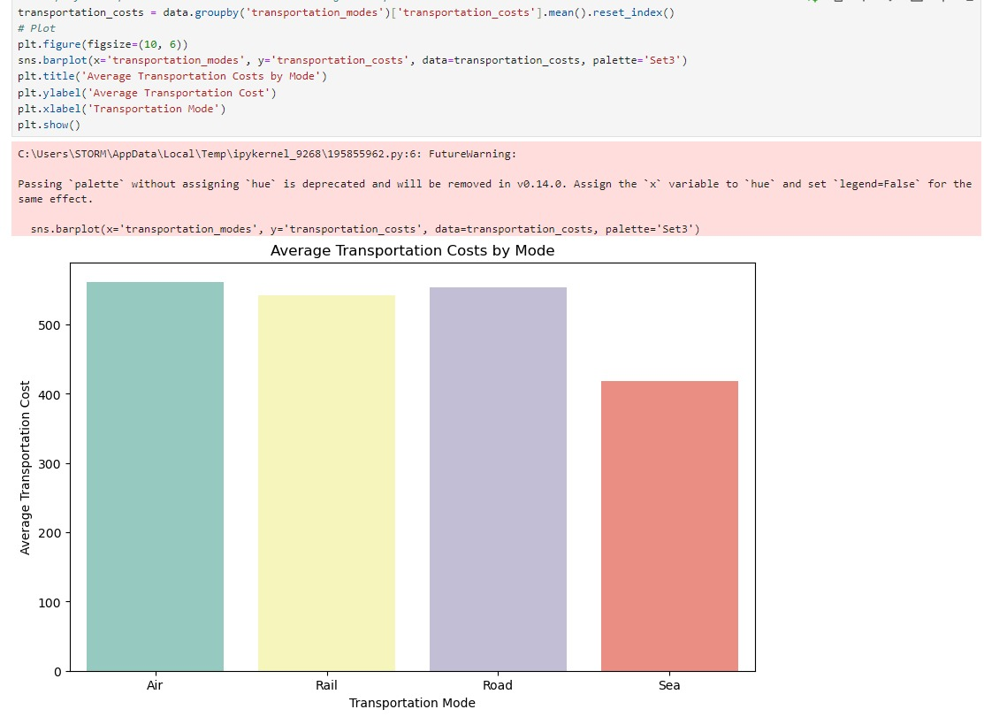
average transportation costs by mode

Slide 25
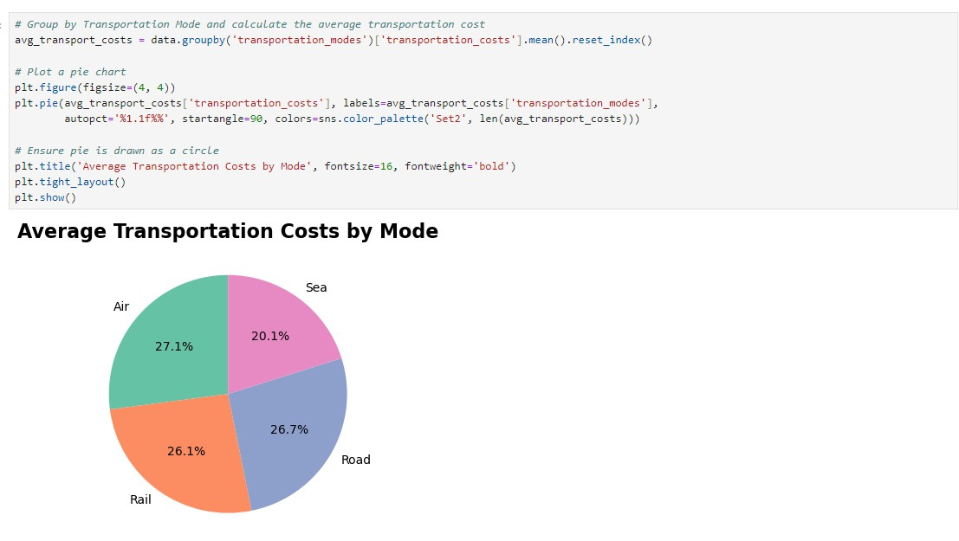

Slide 26
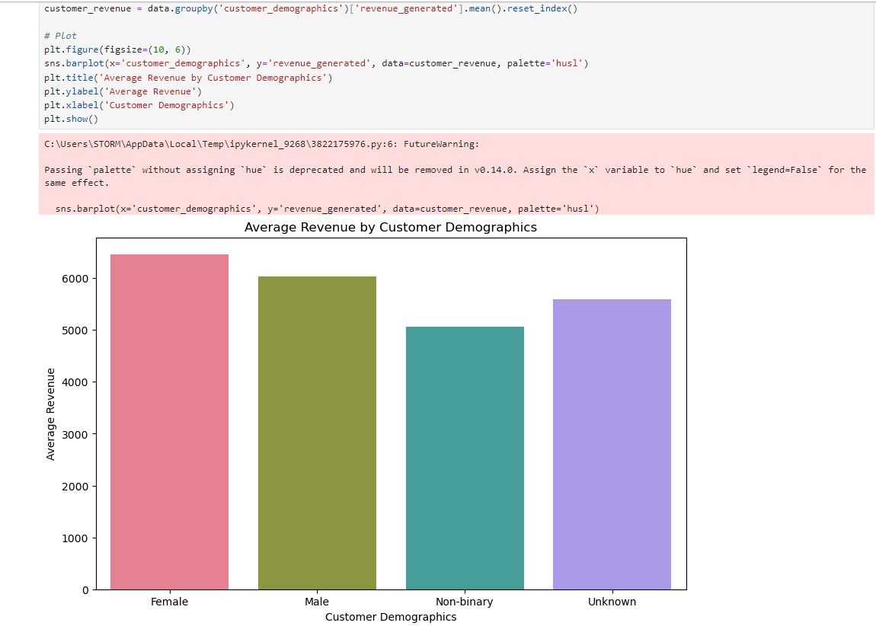
Average revenue by customer demographics

Slide 27
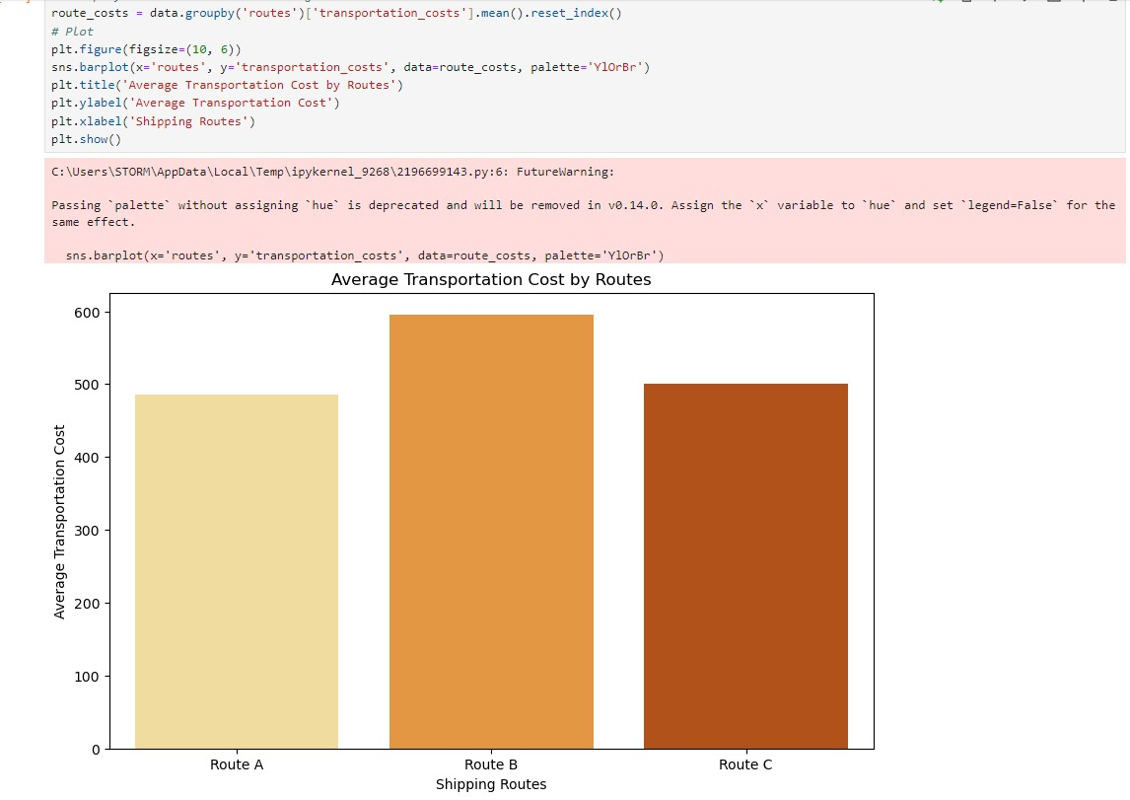
Average transportation cost by routes

Slide 28
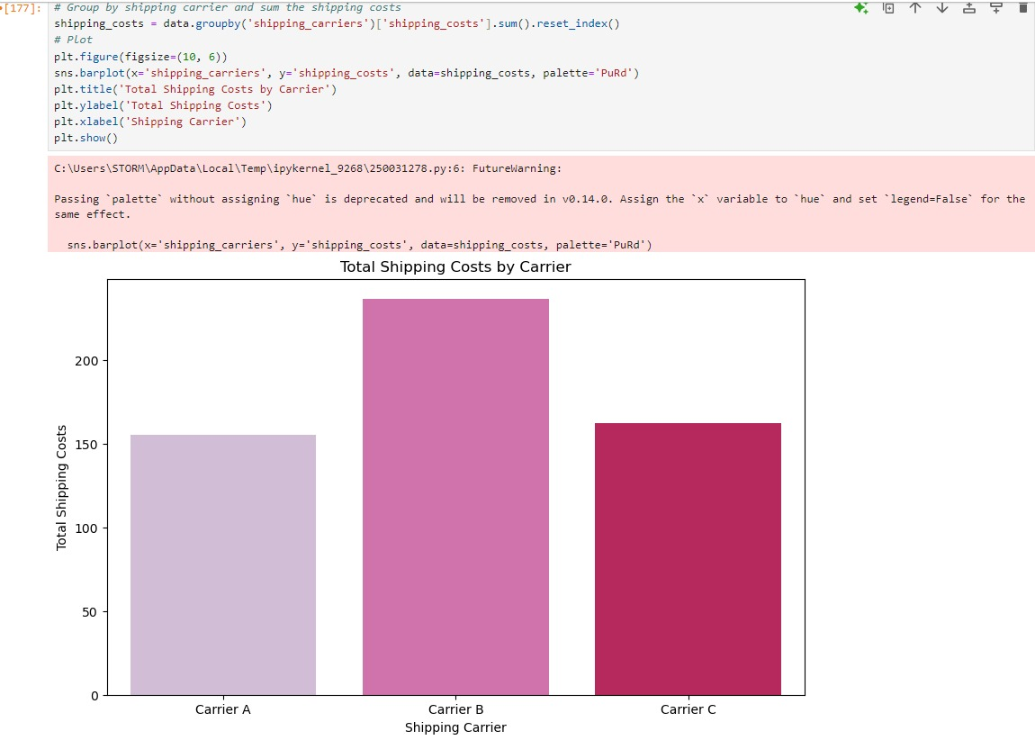
Total shipping cost by carrier

Slide 29
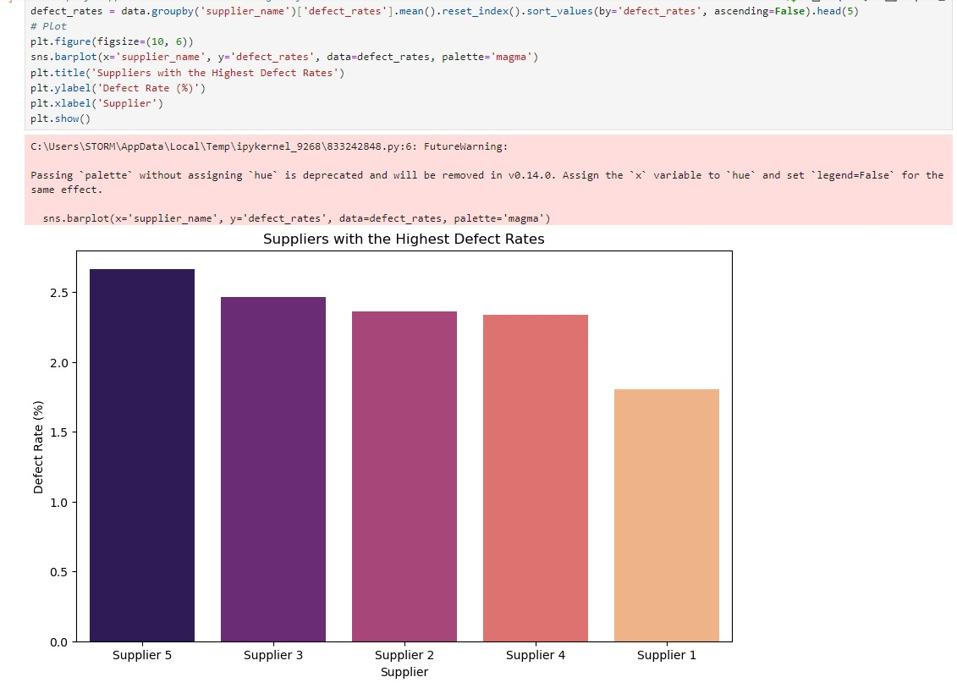
SupplierS with Highest defect rates

Slide 30
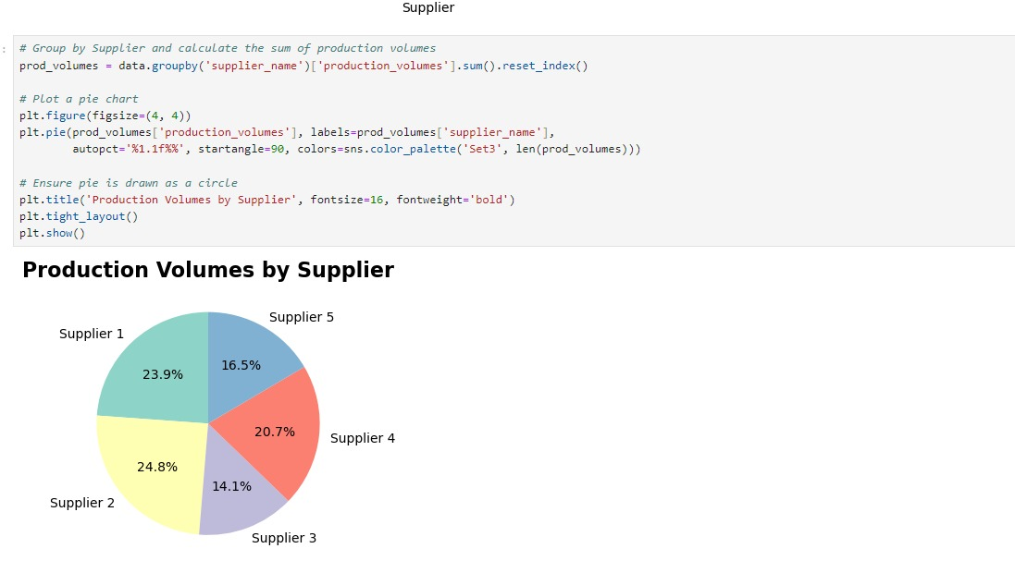
Production volumes by supplier

Slide 31
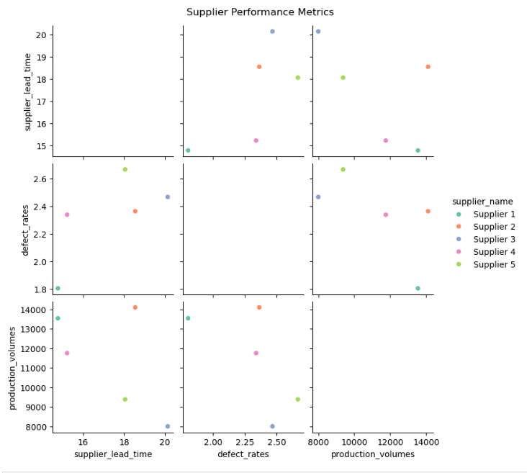
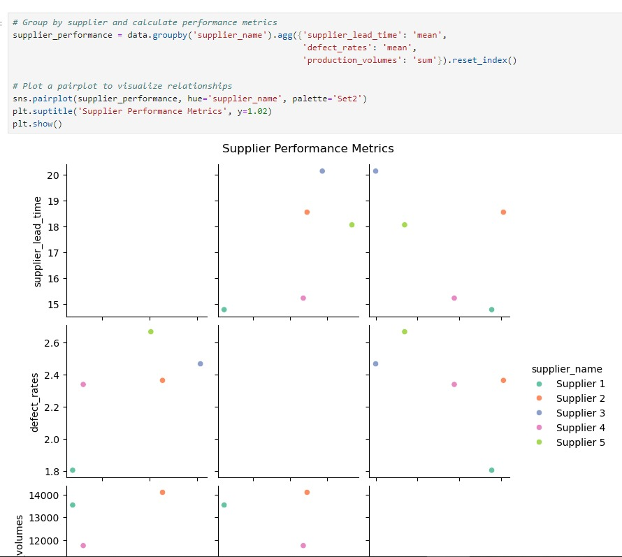
Supplier Performance Metrics

Slide 32
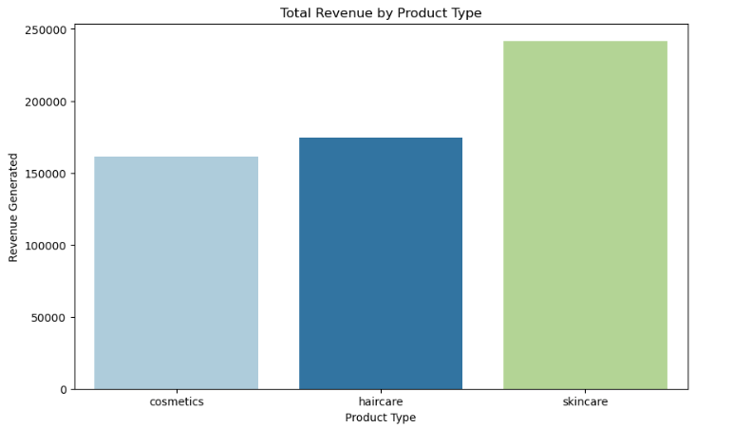
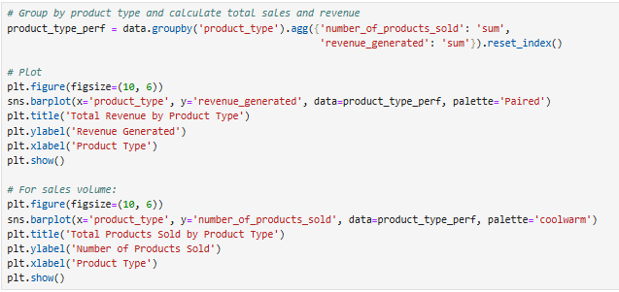
Total revenue by product type

Slide 33
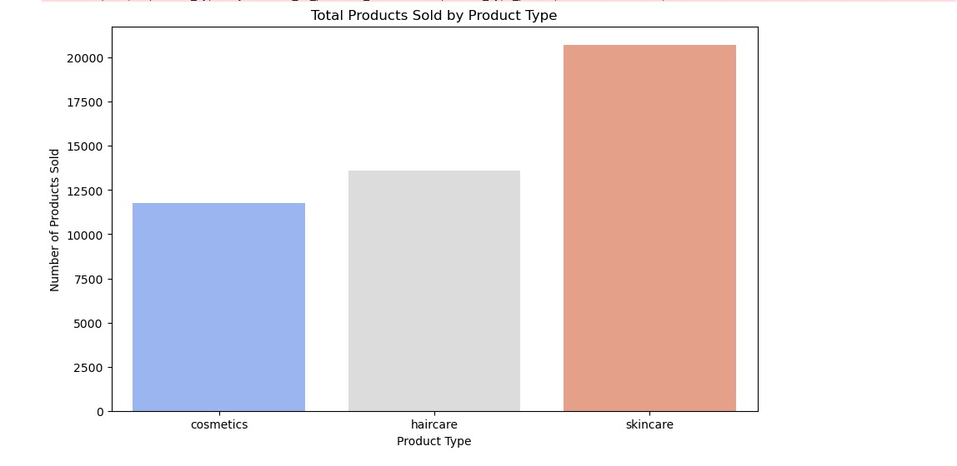
Total products sold by product type

Slide 34
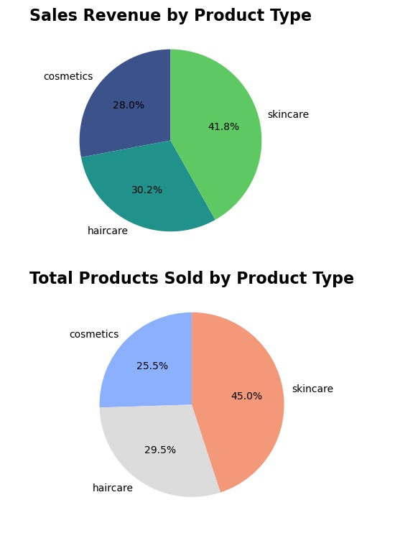
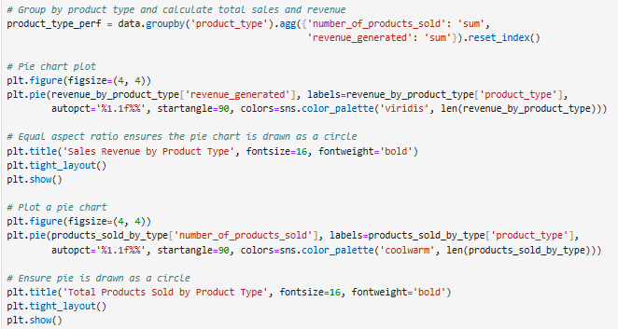
Total sales and revenue

Slide 35
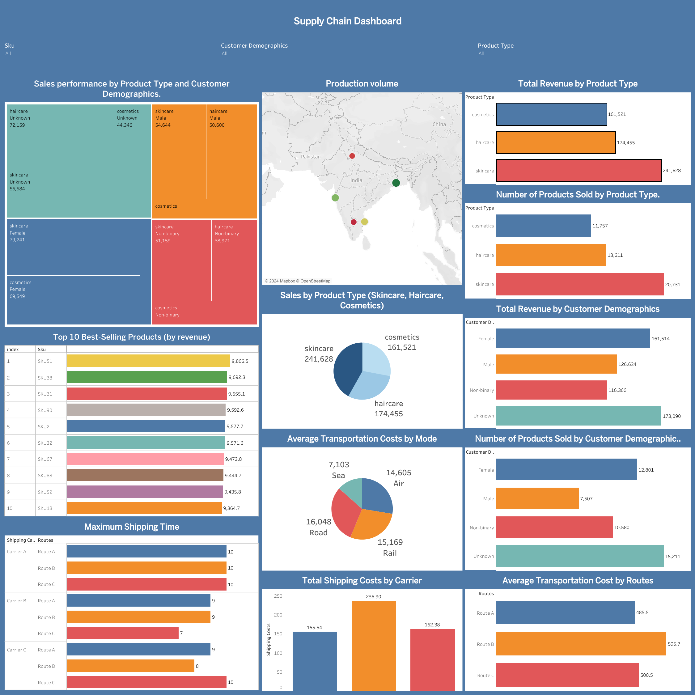
DashBoard

